Slide 1
Elegant optimization

Slide 2
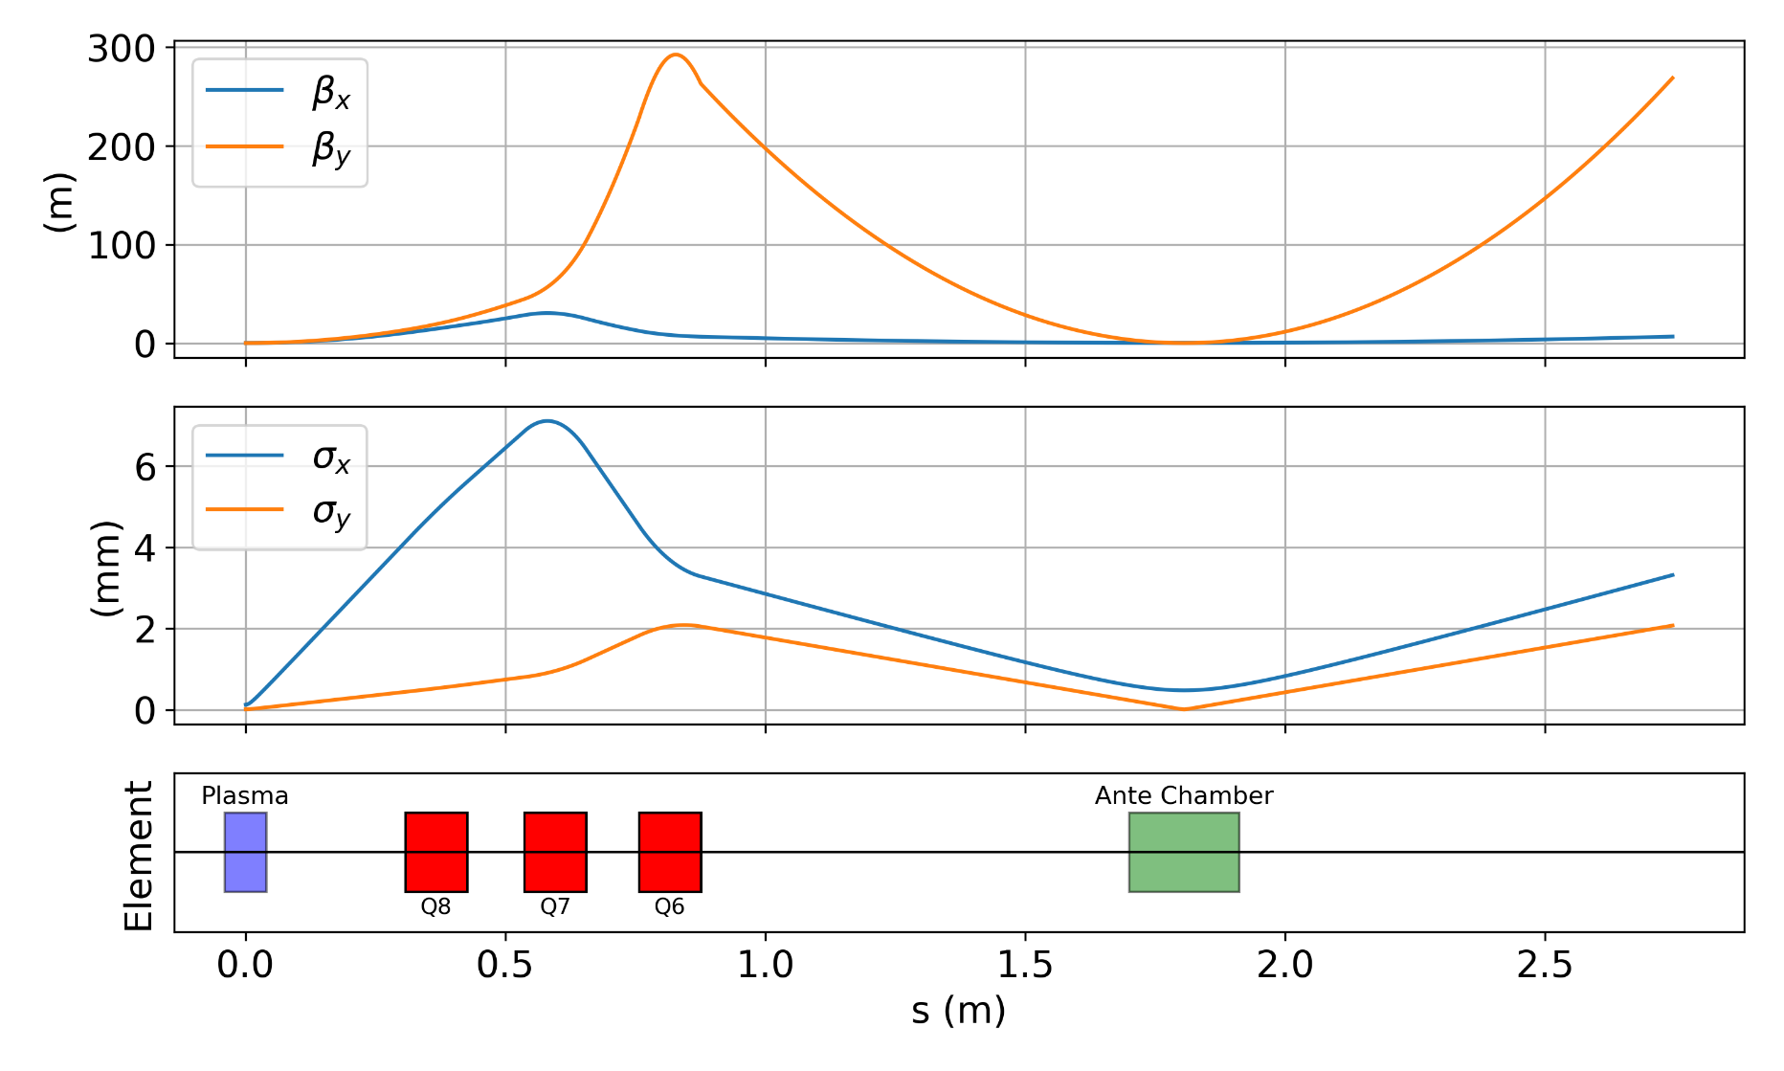

Reverse : Run 1-2
Start from waist
Current Lattice (Changed D11 to 30 cm) : To make sure beta functions at quad are low
$β_{x}$(needed): 0.0092, $β_{y}$(needed): 0.0071
Constraints ($β_{x,max}$,$β_{y,max}:$ 39,300)
Optimizing quads and drift spacing
Small spot size at YAG
YAG

Slide 3
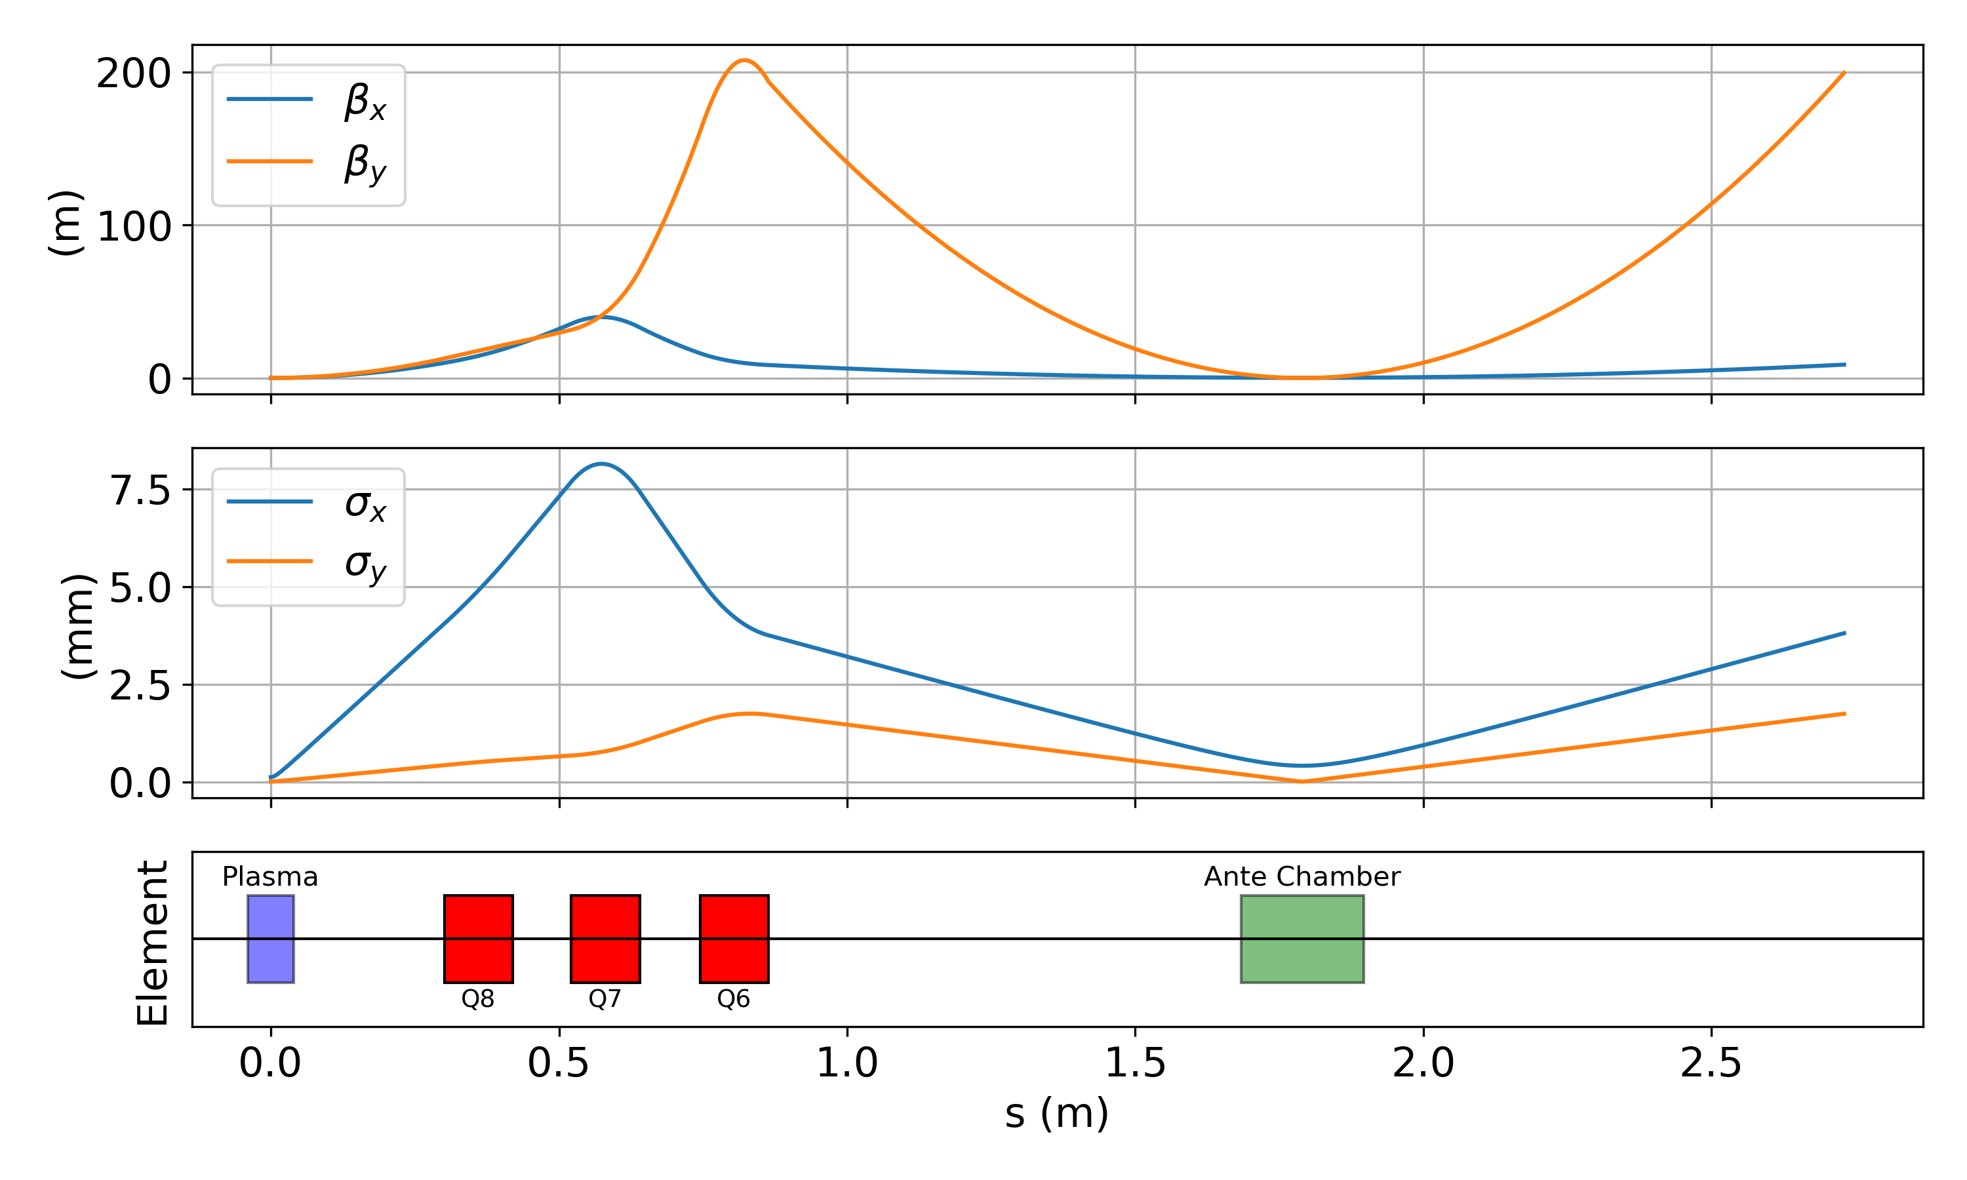


Reverse : Run 3 – Constraining $β_{y}$ to 200
Start from waist
Current Lattice (Changed D11 to 30 cm) : To make sure beta functions at quad are low
$β_{x}$(needed): 0.0092, $β_{y}$(needed): 0.0071
Constraints ($β_{x,max}$,$β_{y,max}:$ 39,200)
Optimizing quads and drift spacing
Small spot size at YAG

Slide 4

Reverse: Run 4 – Matching to initial Twiss parameters
Start from waist
Current Lattice (Changed D11 to 30 cm) : To make sure beta functions at quad are low
Constraints ($β_{x,max}$,$β_{y,max}:$ 39,200)
Optimizing quads and drift spacing
Small spot size at YAG
Asymmetry

Slide 5

Reverse: Run 5 – Reverse matching to initial Twiss parameters but asymmetric spot size
Current Lattice (Changed D11 to 30 cm) : To make sure beta functions at quad are low
Matched to Initial twiss parameters
Constraints ($β_{x,max}$,$β_{y,max}:$ 39,200)
Optimizing quads and drift spacing
Small spot size at YAG
Asymmetry

Slide 6

Forward: Run 6 – Matching to plasma parameters
Optimizing quads and drift spacing
Matched to plasma $β$
Starting from initial twiss parameters
Constraints ($β_{x,max}$,$β_{y,max}:$ 39,200)
Plasma chamber is 30 cm from quad end
YAG could be placed inside chamber?

Slide 7
Forward: Run 7 – Simulated RAW Beam (OPAL)
OPAL beam works in a similar way – Matched to plasma beta functions
YAG could be placed inside chamber?

Slide 8
Emittances (3rd order tracking)
Energy spread : 33 keV
Increases with increase in energy spread

Slide 9
Existing AWA beamline
YAG
YAG
YAG
YAG
cube
22.85
25.13
20.3
20.87
23.62
24.13
25.99
26.69
27.3
27.64
27.98
21.08
23.87
26.34
(in m)
YAG
Experimental setup - FBPWFA
YAG
YAG
Slit
Window
plasma
20.3
22.85
20.87
23.62
24.13
25.13
26.12
26.56
26.92
27.3
21.08
23.87
26.34
(in m)

